Slide 1
Detection of Deepfakes Detecting Nonlinearities using Bispectral Analysis
Speech Group 10/04/2024
Anthony White

Slide 2
Nonlinear Systems
Nonlinear systems add frequency components to the output which are not present in the input.
The speech production model (for real speech) can be approximated by a linear model.
Synthetic speech production models are usually nonlinear.

Slide 3
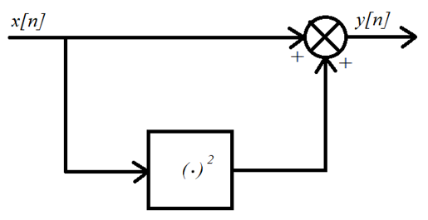
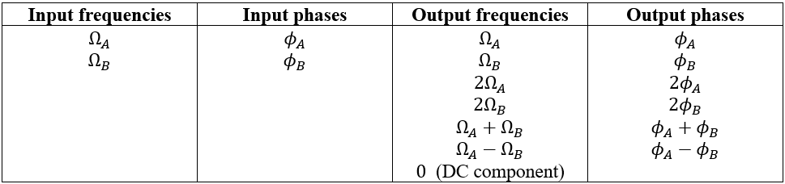

Quadratically Nonlinear Systems
Quadratically nonlinear systems add frequency components at double any frequencies at the input, and at sums/differences of frequencies at the input.
Considering an input :

Slide 4

Quadratic Phase Coupling (QPC)
When $y[n]$ is the output of a quadratically nonlinear process,
$$∠{Y\left(Ω_{A}+Ω_{B}\right)}=∠{Y(Ω_{A})}+∠{Y(Ω_{B})}$$
where $Y(Ω)$ is the Fourier transform of $y[n]$.

Slide 5
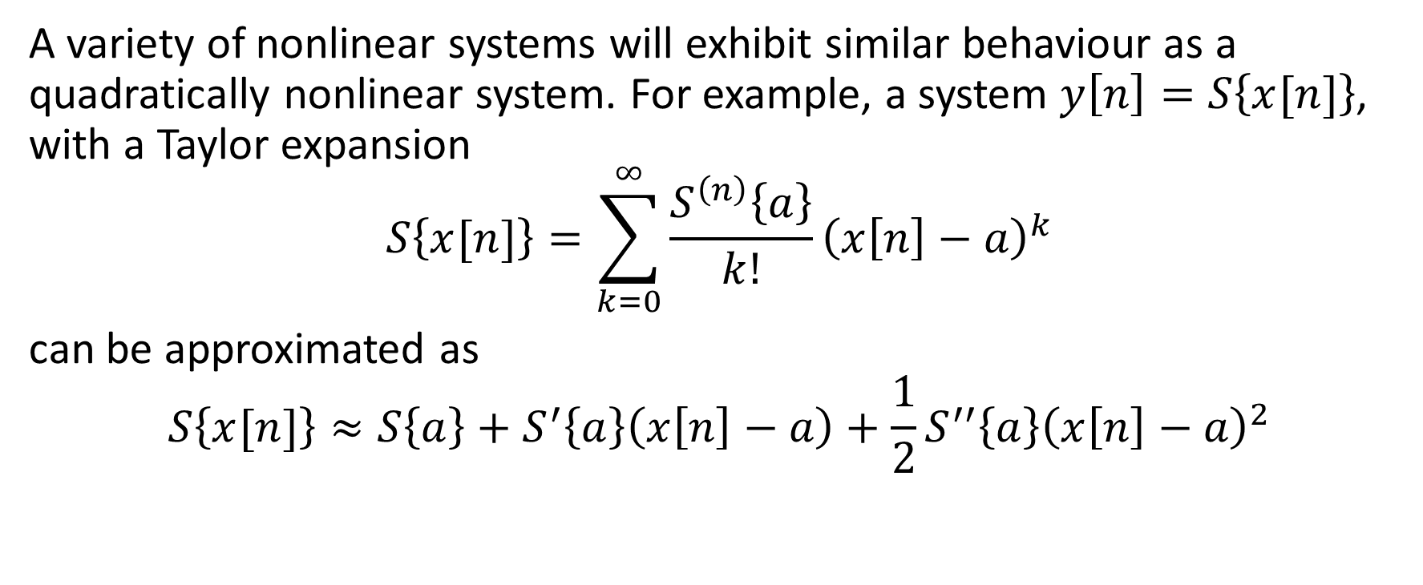
Arbitrarily Nonlinear Systems
A variety of nonlinear systems will exhibit similar behaviour as a quadratically nonlinear system. For example, a system $y\left[n\right]=S\left\{x[n]\right\}$, with a Taylor expansion
$$S\left\{x[n]\right\}=\sum_{k=0}^{∞}{\frac{S^{\left(n\right)}\left\{a\right\}}{k!}{\left(x\left[n\right]−a\right)}^{k}}$$
can be approximated as
$$S\left\{x[n]\right\}≈S\left\{a\right\}+S^{′}\left\{a\right\}\left(x\left[n\right]−a\right)+\frac{1}{2}S^{′′}\left\{a\right\}{\left(x\left[n\right]−a\right)}^{2}$$
Constant term
Linear term
Quadratic term

Slide 6
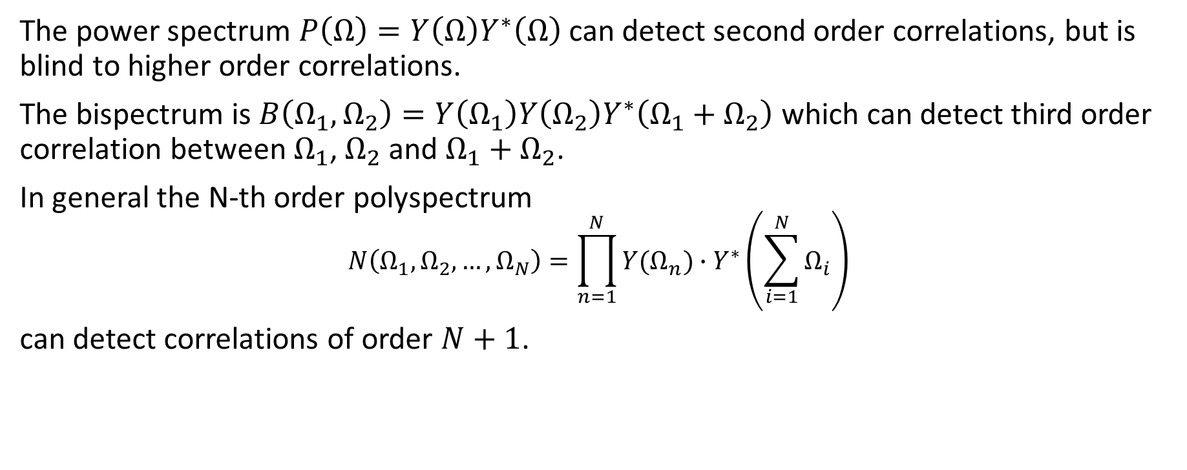
The Bispectrum
The power spectrum $P\left(Ω\right)=Y\left(Ω\right)Y^{∗}\left(Ω\right)$ can detect second order correlations, but is blind to higher order correlations.
The bispectrum is $B\left(Ω_{1},Ω_{2}\right)=Y\left(Ω_{1}\right)Y\left(Ω_{2}\right)Y^{∗}\left(Ω_{1}+Ω_{2}\right)$ which can detect third order correlation between $Ω_{1}$, $Ω_{2}$ and $Ω_{1}+Ω_{2}$.
In general the N-th order polyspectrum
$$N\left(Ω_{1},Ω_{2},…,Ω_{N}\right)=\prod_{n=1}^{N}{Y(Ω_{n})}∙Y^{∗}\left(\sum_{i=1}^{N}{Ω_{i}}\right)$$
can detect correlations of order $N+1$.

Slide 7
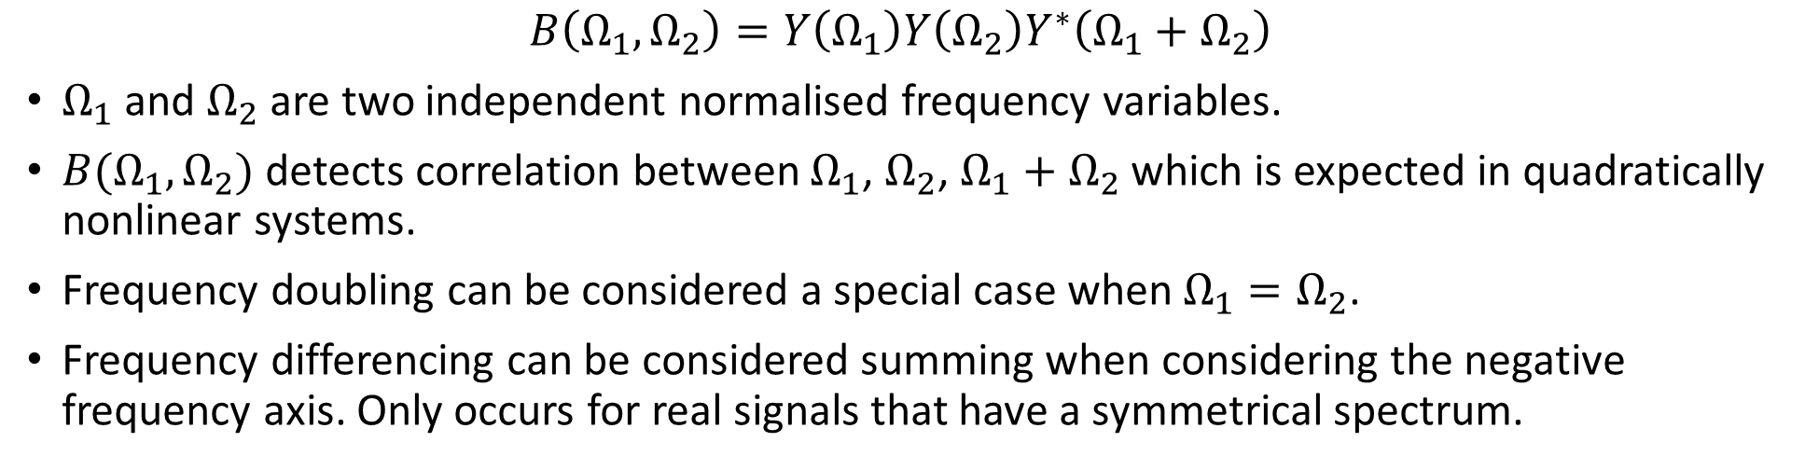
The Bispectrum
$$B\left(Ω_{1},Ω_{2}\right)=Y\left(Ω_{1}\right)Y\left(Ω_{2}\right)Y^{∗}\left(Ω_{1}+Ω_{2}\right)$$
$Ω_{1}$ and $Ω_{2}$ are two independent normalised frequency variables.
$B(Ω_{1},Ω_{2})$ detects correlation between $Ω_{1}$, $Ω_{2}$, $Ω_{1}+Ω_{2}$ which is expected in quadratically nonlinear systems.
Frequency doubling can be considered a special case when $Ω_{1}=Ω_{2}$.
Frequency differencing can be considered summing when considering the negative frequency axis. Only occurs for real signals that have a symmetrical spectrum.

Slide 8
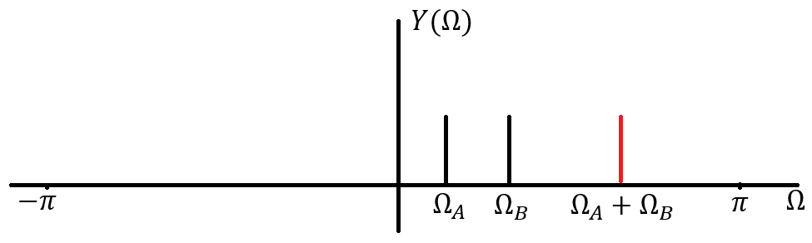
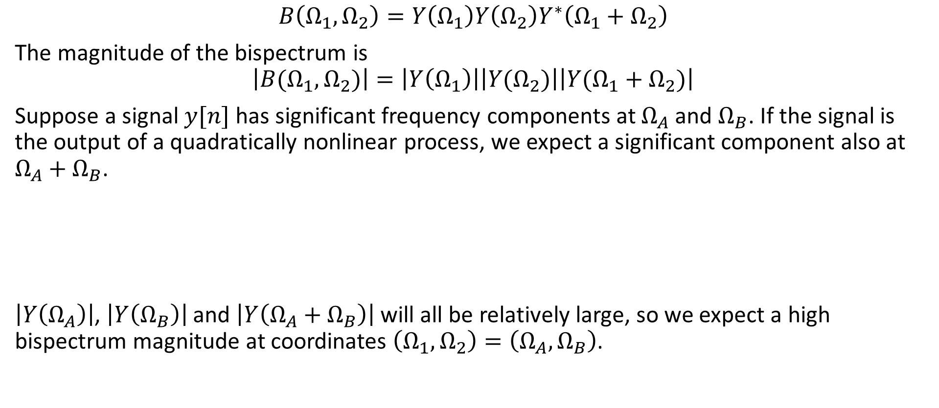
Bispectrum Magnitude
$$B\left(Ω_{1},Ω_{2}\right)=Y\left(Ω_{1}\right)Y\left(Ω_{2}\right)Y^{∗}\left(Ω_{1}+Ω_{2}\right)$$
The magnitude of the bispectrum is
$$\left|B(Ω_{1},Ω_{2})\right|=\left|Y\left(Ω_{1}\right)\right|\left|Y(Ω_{2})\right|\left|Y(Ω_{1}+Ω_{2})\right|$$
Suppose a signal $y[n]$ has significant frequency components at $Ω_{A}$ and $Ω_{B}$. If the signal is the output of a quadratically nonlinear process, we expect a significant component also at $Ω_{A}+Ω_{B}$.
$\left|Y\left(Ω_{A}\right)\right|$, $\left|Y\left(Ω_{B}\right)\right|$ and $\left|Y\left(Ω_{A}+Ω_{B}\right)\right|$ will all be relatively large, so we expect a high bispectrum magnitude at coordinates $\left(Ω_{1},Ω_{2}\right)=\left(Ω_{A},Ω_{B}\right)$.

Slide 9
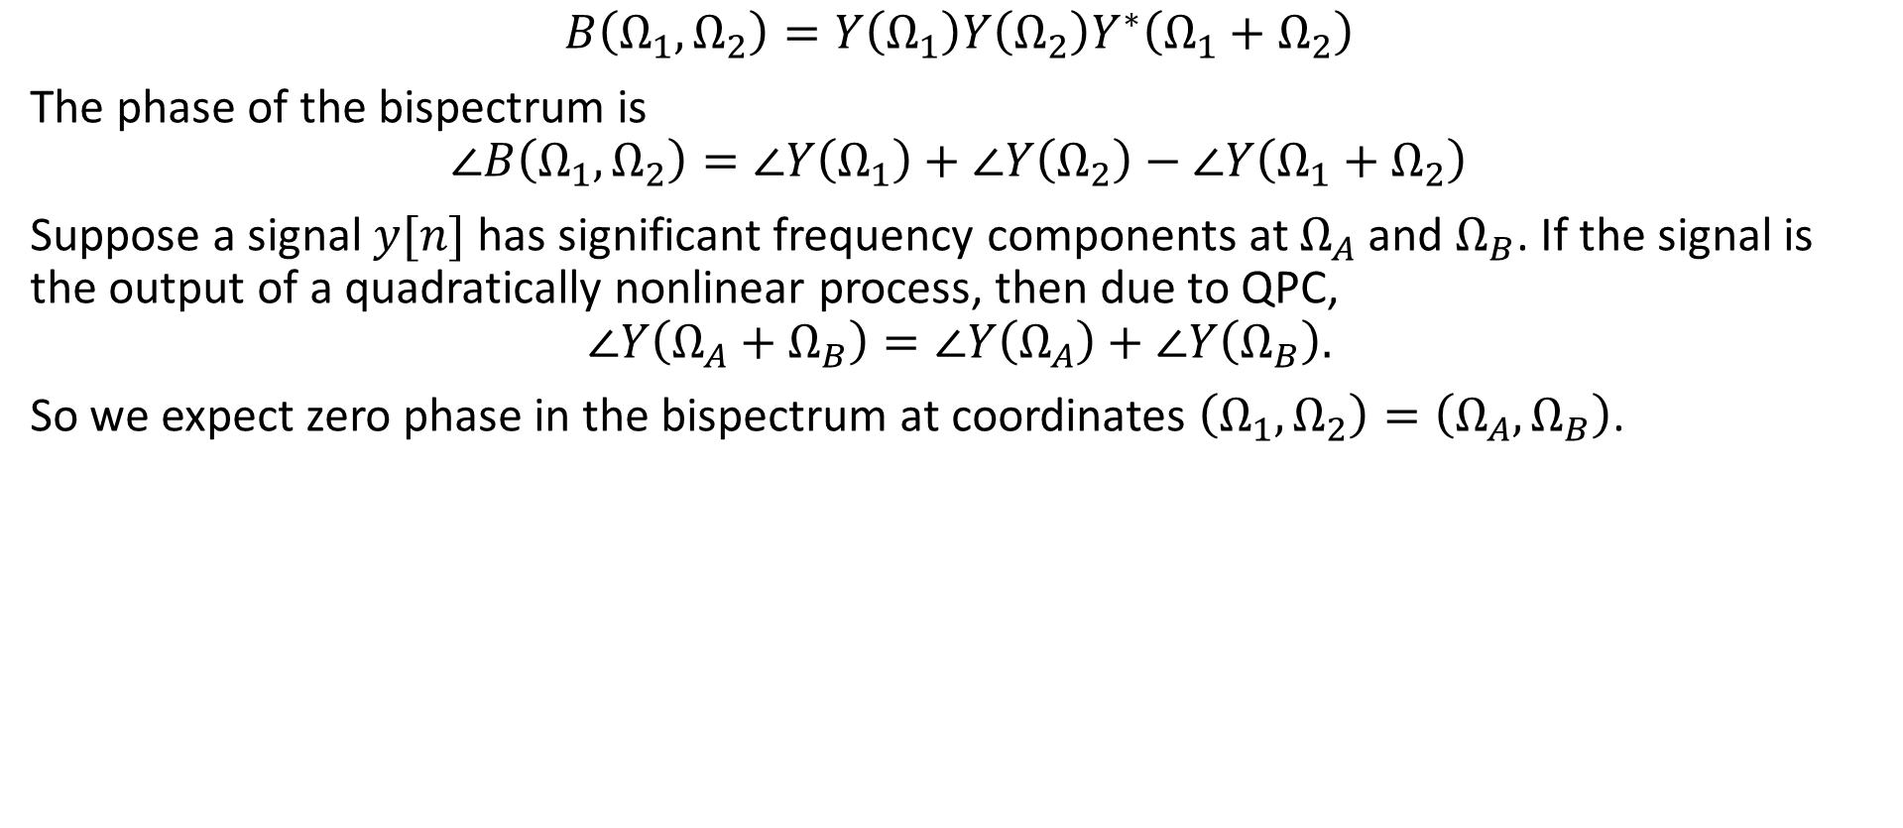
Bispectrum Phase
$$B\left(Ω_{1},Ω_{2}\right)=Y\left(Ω_{1}\right)Y\left(Ω_{2}\right)Y^{∗}\left(Ω_{1}+Ω_{2}\right)$$
The phase of the bispectrum is
$$∠B\left(Ω_{1},Ω_{2}\right)=∠Y\left(Ω_{1}\right)+∠Y\left(Ω_{2}\right)−∠Y\left(Ω_{1}+Ω_{2}\right)$$
Suppose a signal $y[n]$ has significant frequency components at $Ω_{A}$ and $Ω_{B}$. If the signal is the output of a quadratically nonlinear process, then due to QPC,
$$∠Y\left(Ω_{A}+Ω_{B}\right)=∠Y\left(Ω_{A}\right)+∠Y\left(Ω_{B}\right).$$
So we expect zero phase in the bispectrum at coordinates $\left(Ω_{1},Ω_{2}\right)=\left(Ω_{A},Ω_{B}\right)$.

Slide 10
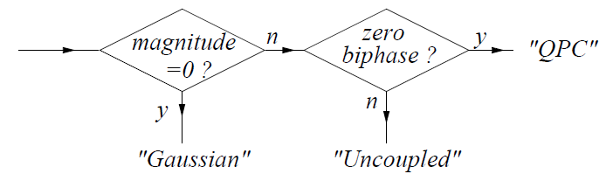

Detecting Quadratic Nonlinearities
Things we are looking for in the bispectrum:
Large magnitudes in the bispectrum
When magnitude is large, phase is approximately zero.
The bispectrum was invented a long time ago, however people have only recently thought to use it for synthetic speech detection (2019 onwards).

Slide 11
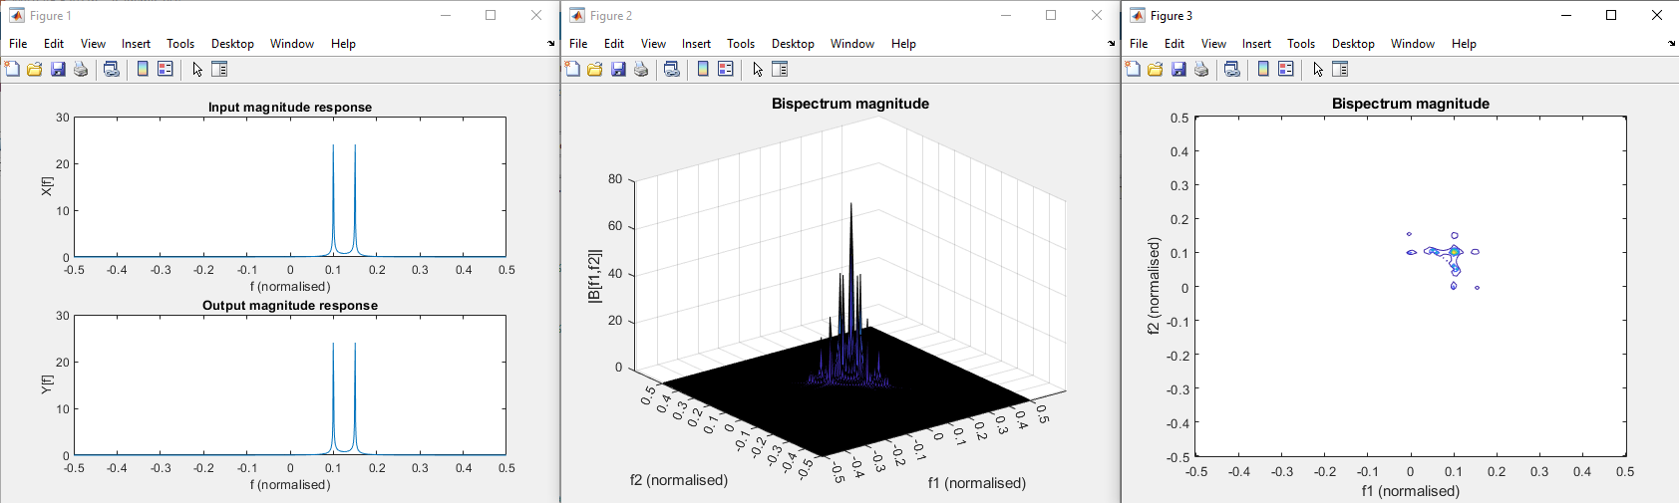

Bispectrum of Sum of Complex Exponentials
No nonlinearities should be detected.
Used MATLAB to calculate and plot $B$. Used 1024 point FFTs. Bispectrum is binned to 128.
Signal is $x\left[n\right]=e^{j2πf_{1}n}+e^{j2πf_{2}n}$ with normalised frequencies $f_{1}=0.1$ and $f_{2}=0.15$.

Slide 12
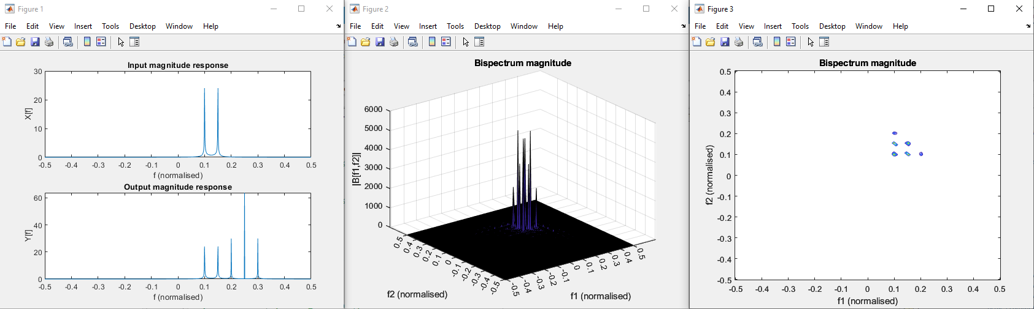

Bispectrum of Sum of Complex Exponentials
Now, pass $x[n]{=e}^{j2πf_{1}n}+e^{j2πf_{2}n}$through a quadratically nonlinear system
$y\left[n\right]=x^{2}\left[n\right]+x[n]$ and calculate the bispectrum of $y[n]$.
Highest peaks are around 700, compared to before which were around 15.
Peaks at $B\left(f_{1},f_{1}\right)$, $B(f_{1},f_{2})$, $B(f_{2},f_{1})$, $B(f_{2},f_{2})$.

Slide 13
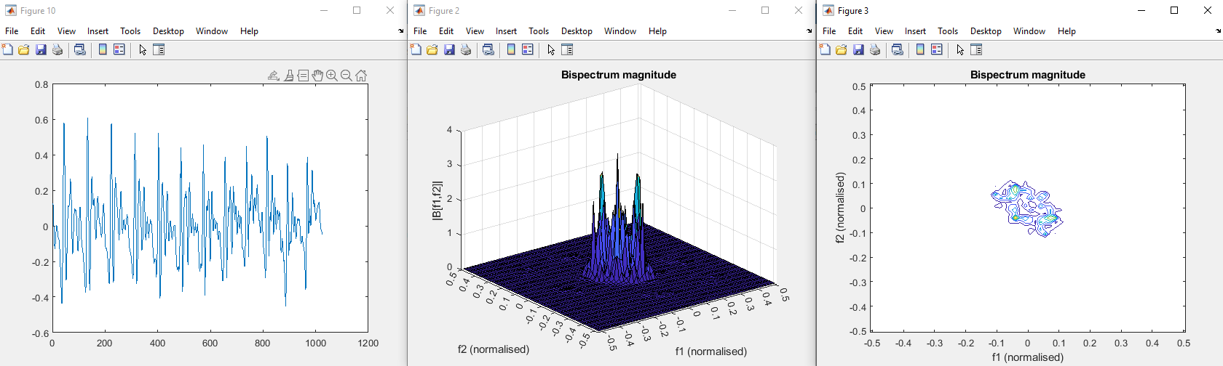
Bispectrum of Natural Speech
Highest peak around 3.75

Slide 14
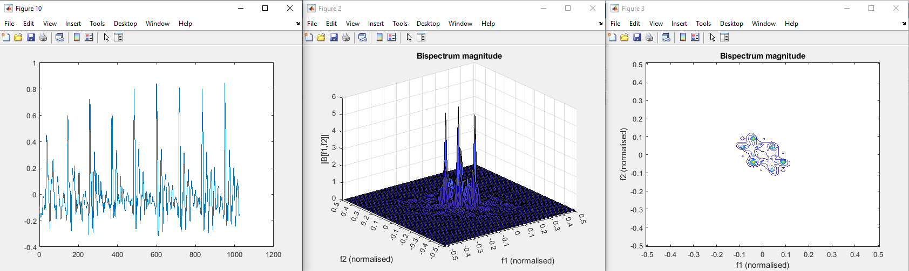
Bispectrum of Synthetic Speech
Highest peak around 6

Slide 15

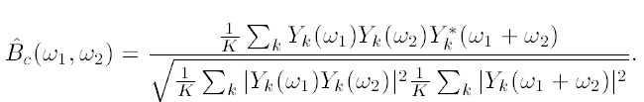

Bicoherence
The bicoherence is the normalised bispectrum. Magnitude is normalised from 0-1.
For long speech signals, the bicoherence is estimated from the biocoherence of $K$ windowed segments of the speech,

